Slide 1
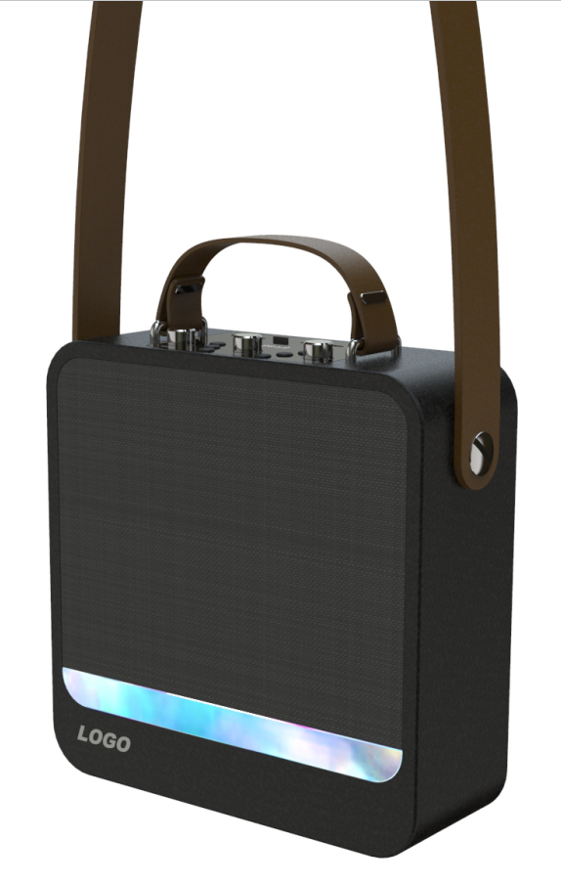
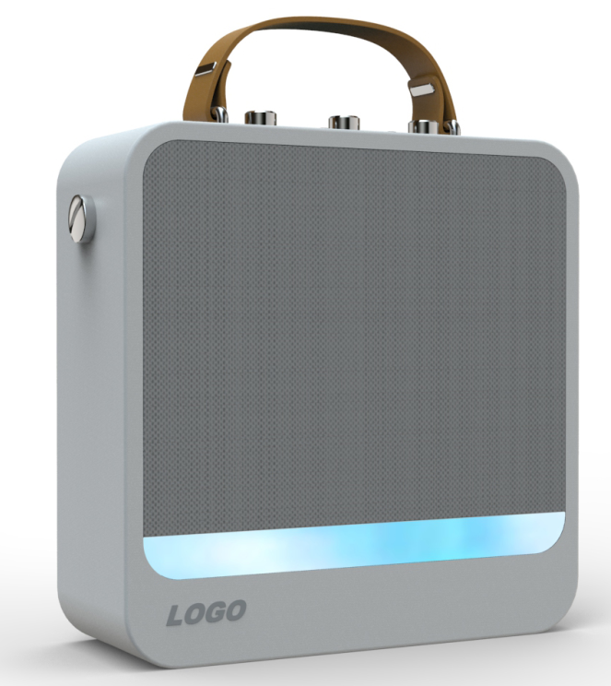
Backpack Wooden BT Karaoke Machine FY-50
2021 New Item
1. With wire or wireless microphone, singing together with speaker (Option)
2. With LED light at front, showing fashionable colorful light.
3. Output : 30W
4. Music via Bluetooth V5.0 or Micro SD card, USB or AUX-IN(mobile phone, tablets, PC...
5. Built-in rechargeable 4000mAh battery
6. Size: 275*275*100MM
BT + AUX + USB + TF + FM + Front LED light

Slide 2
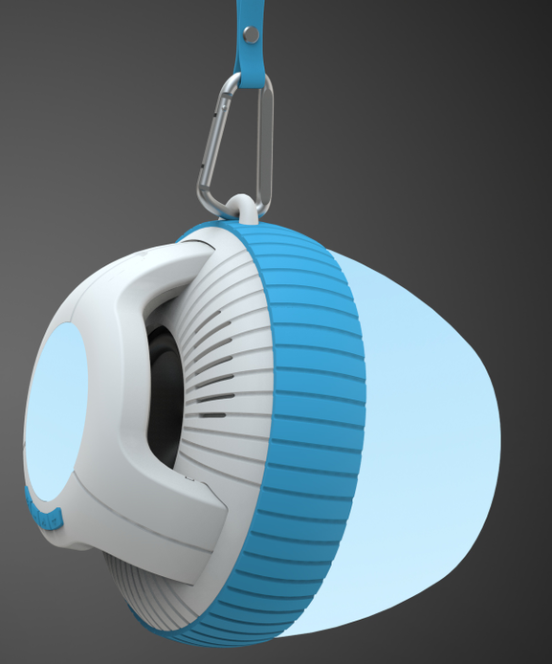
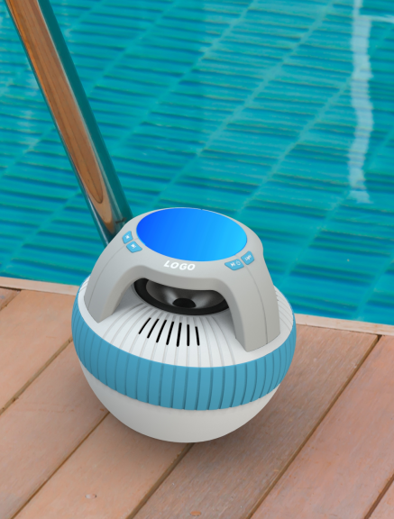
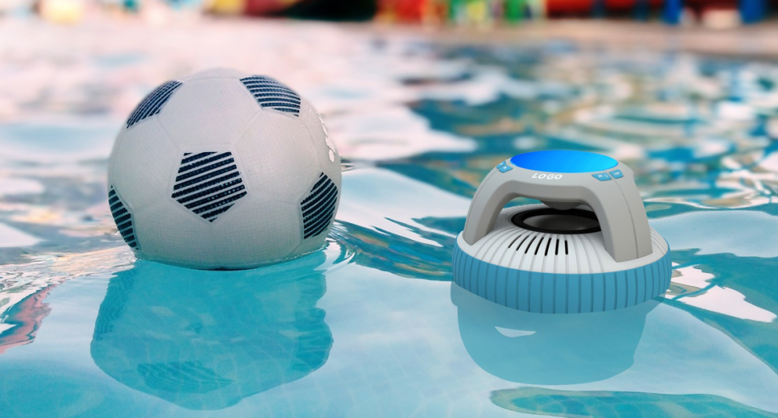
IPX68 Waterproof Swimming Pool Floating BT Speaker with Colorful LED light
1. With IP68 waterproof rating, the Bluetooth speaker is able to go everywhere, never afraid of water and rain. It’s ideal uses not only in pools and spas, but also on the patio, at beach parties, as an indoor accent.
2. Music via Bluetooth V5.0 or Micro SD card, or AUX-IN(mobile phone, tablets, PC...)
3. Output: Rms 6W (6W * 1). Bulit in passitive radiator, good sound quality.
4. With Colorful LED display at the top and bottom of speaker, provide beautiful visual enjoyment to you and your family.
6. Bulit in 2000mAh rechargeable battery.
Working time more than 4-8 hours.

Slide 3
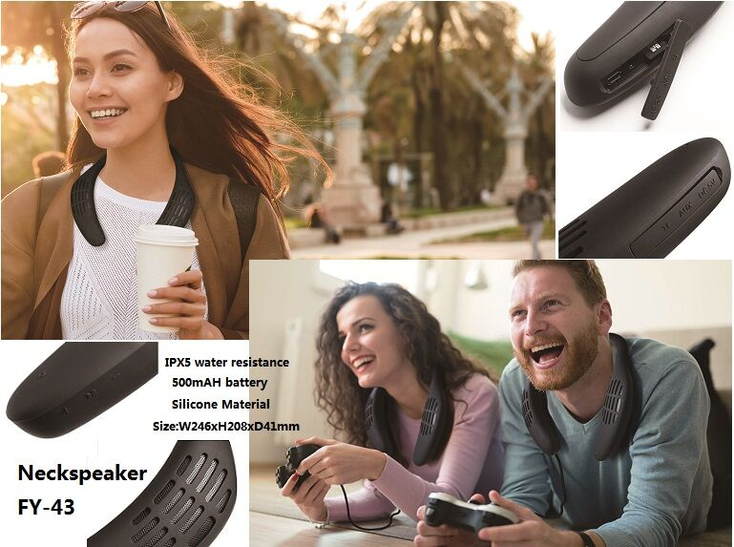
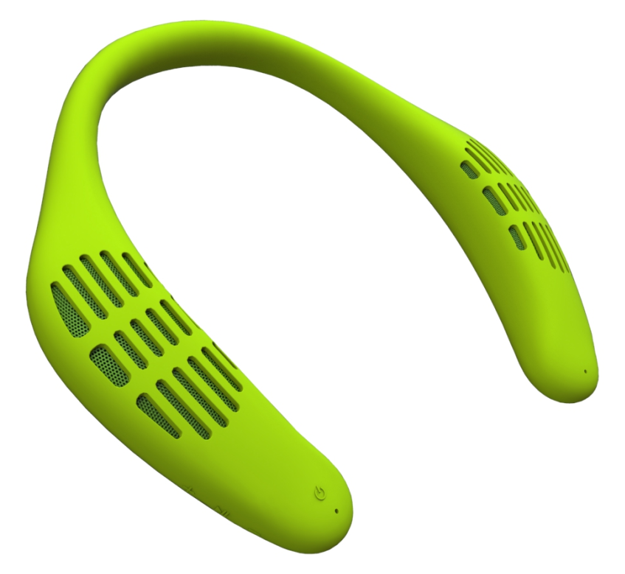
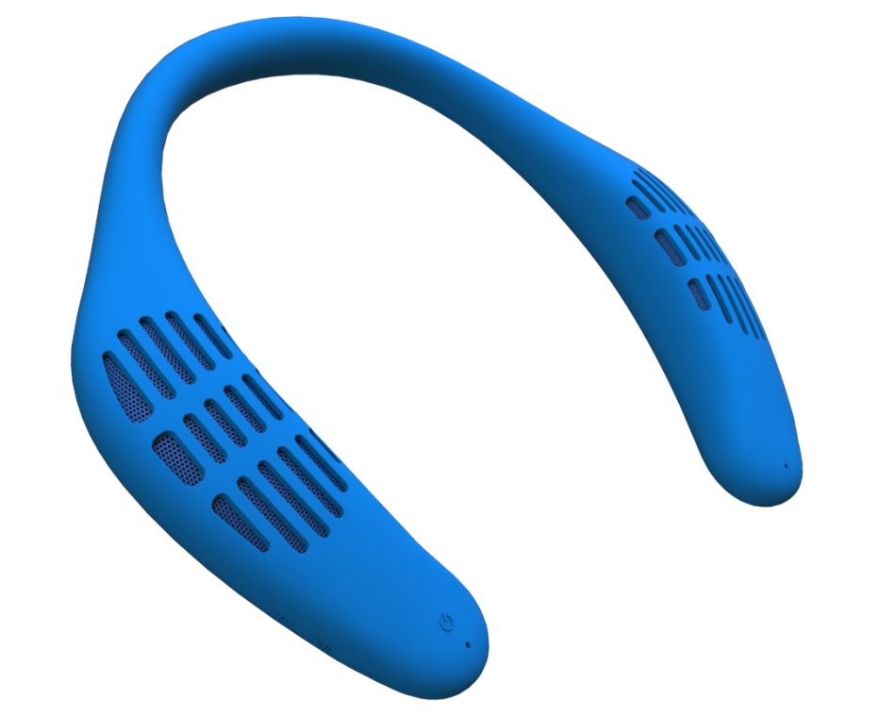
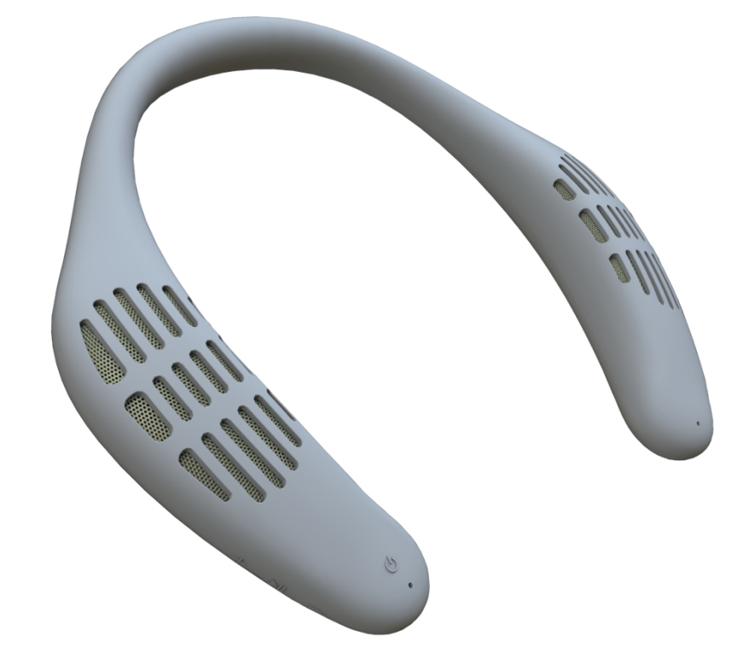
IPX5 Water Resistance Silicone Neckband BT Speaker FY-43
Specification:
1. Music via Bluetooth V5.0 or Micro SD card, or AUX-IN(mobile phone, tablets, PC...
2. Output: Rms 6W (3W * 2). Bulit in passitive radiator, good sound quality.
3. IPX5 water resistance speaker.
4. High quality full silicone material, very comfortable for using.
5. Bulit in 500mAh rechargeable battery.

Slide 4
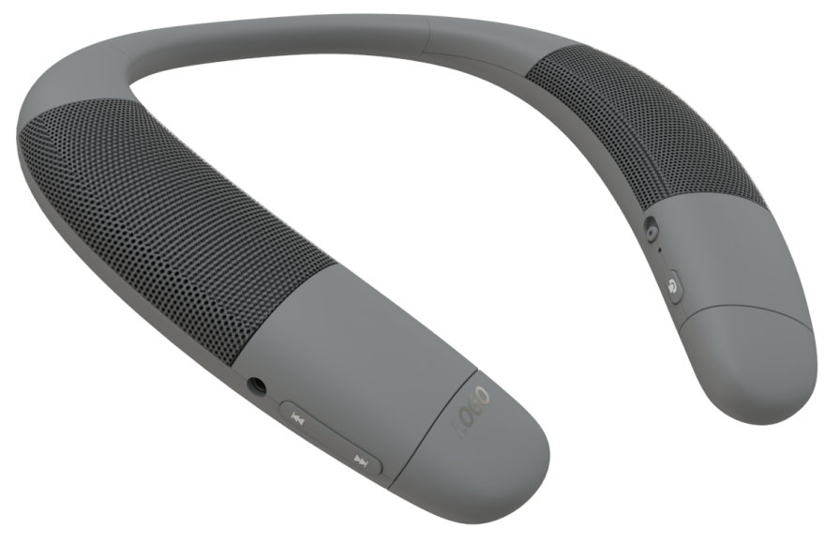
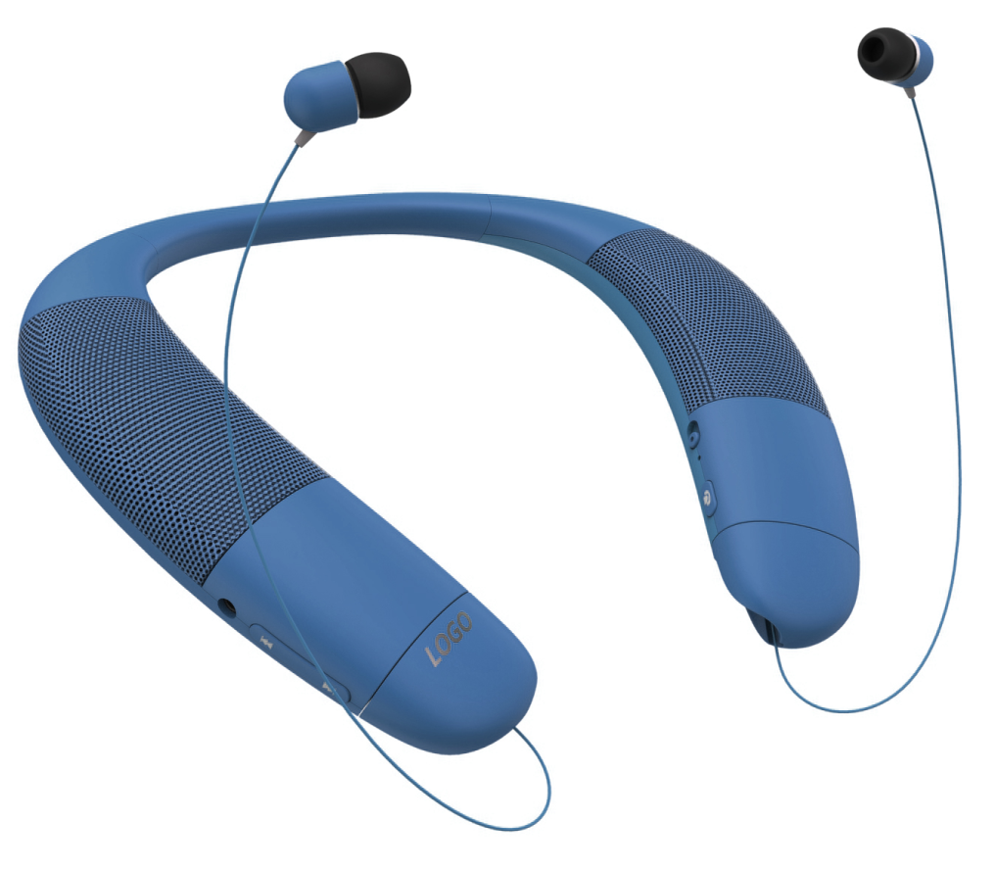
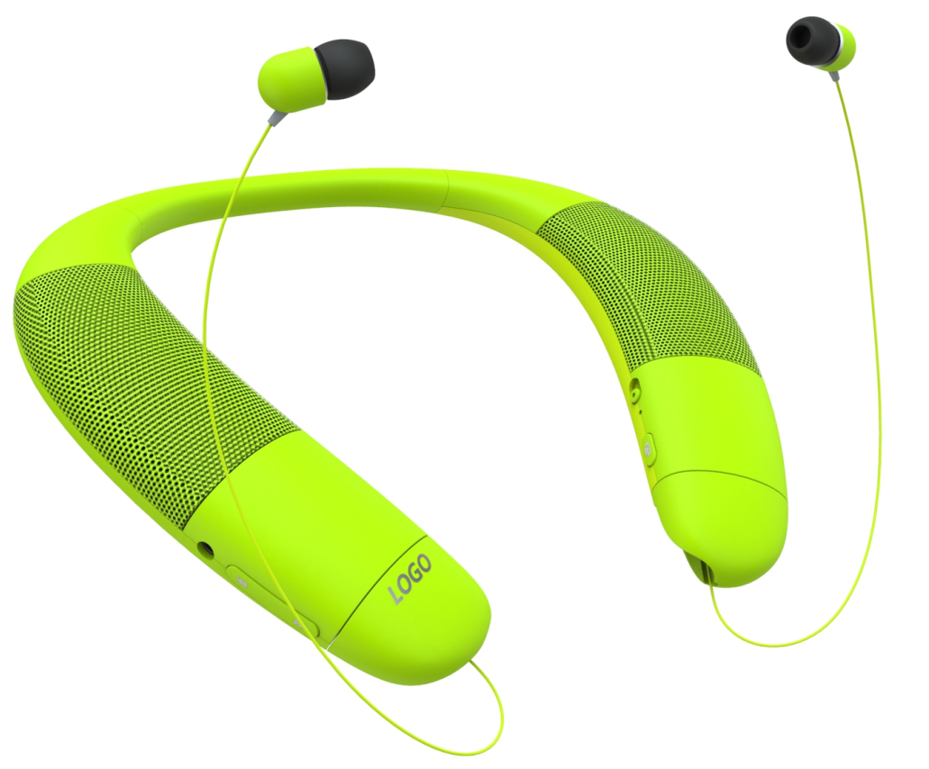
2-1 Neckband BT Speaker Earphone FY-45A
Specification:
1. Music via Bluetooth V5.0 or Micro SD card, or AUX-IN(mobile phone, tablets, PC...
2. Output: Rms 6W (3W * 2). Bulit in passitive radiator, good sound quality.
3. With both BT speaker and BT earphone function.
4. With silicone material at neckband, very comfortable for using.
5. Bulit in 500mAh rechargeable battery.

Slide 5
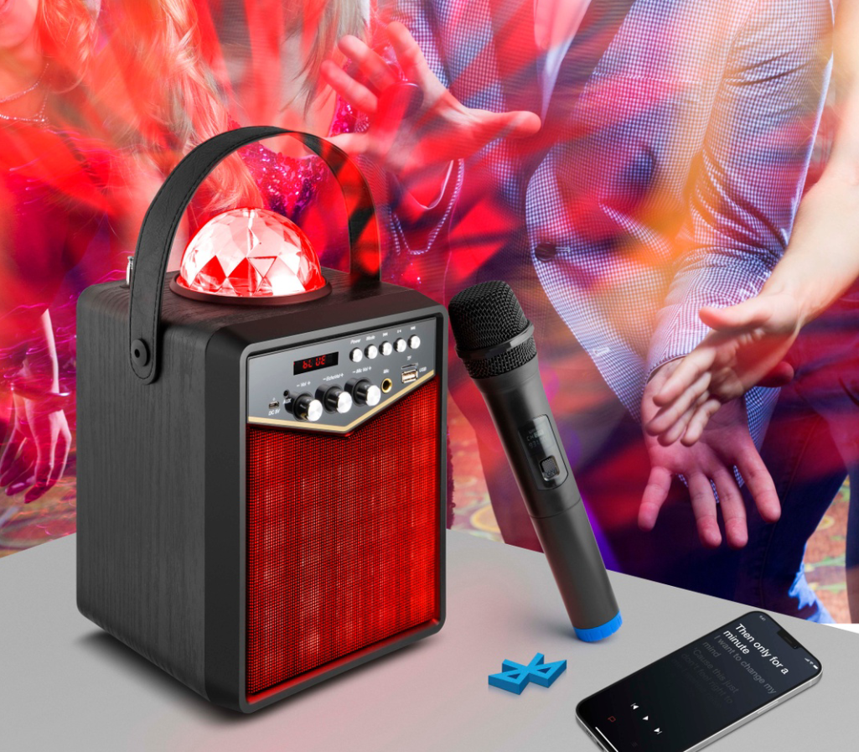
20W Disco Wooden Speaker (with wire or wireless karaoke microphone) FY-38
Huge Quantity for ALDI EU
Specification:
1. With wire or wireless microphone, singing together with speaker (Option)
2. With LED disco light at top, showing fashionable colorful light.
3. Output : 20W
4. Music via Bluetooth V5.0 or Micro SD card, USB or AUX-IN(mobile phone, tablets, PC...
5. Built-in rechargeable 4000mAh battery
6. Size: W190*D165*H267.5MM

Slide 6
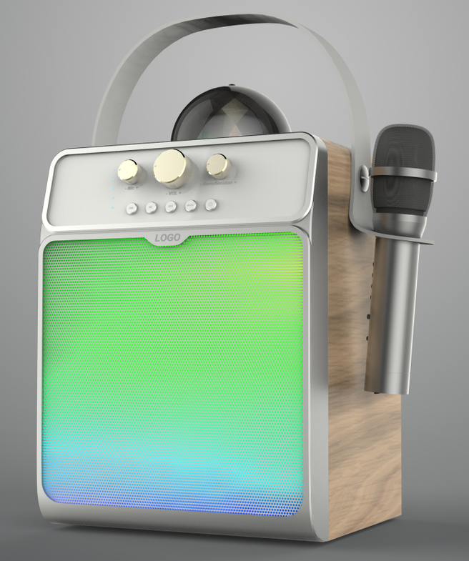
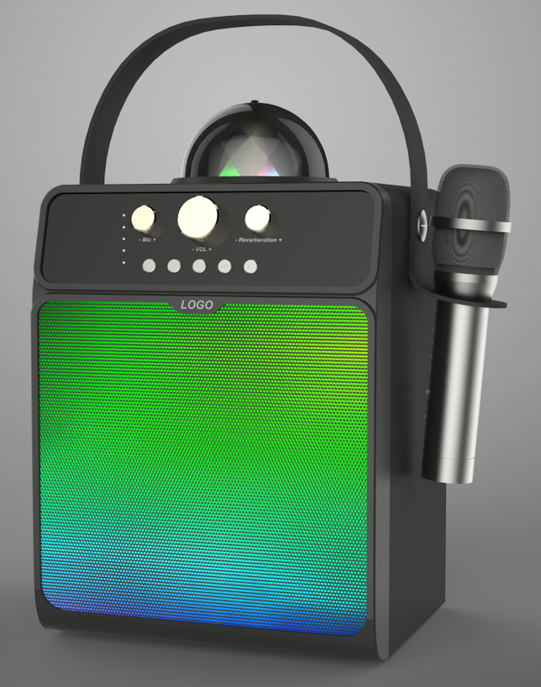
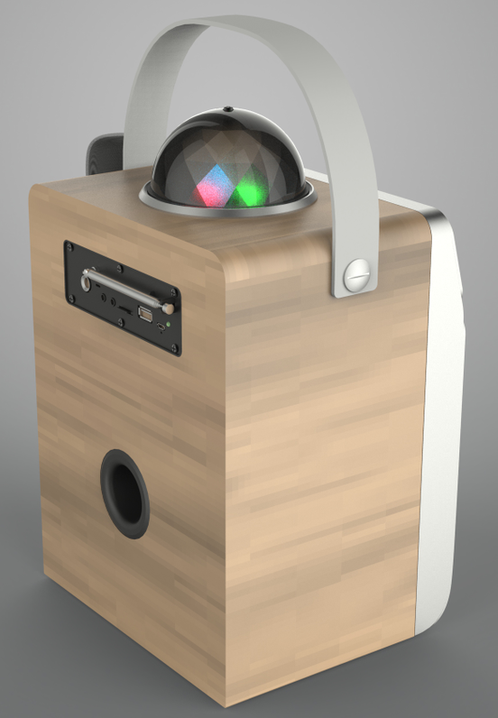
25W Disco Wooden Speaker (with wire or wireless karaoke microphone) FY-40
2021 New Item
Specification:
1. With wire or wireless microphone, singing together with speaker (Option)
2. With LED disco light at top, front LED light, showing fashionable colorful light.
3. Output : 20W
4. Music via Bluetooth V5.0 or Micro SD card, USB or AUX-IN(mobile phone, tablets, PC...
5. Built-in rechargeable 4000mAh battery
6. Size: W190*D165*H267.5MM

Slide 7
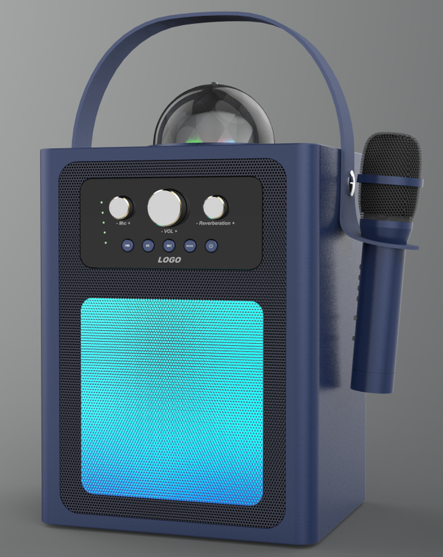
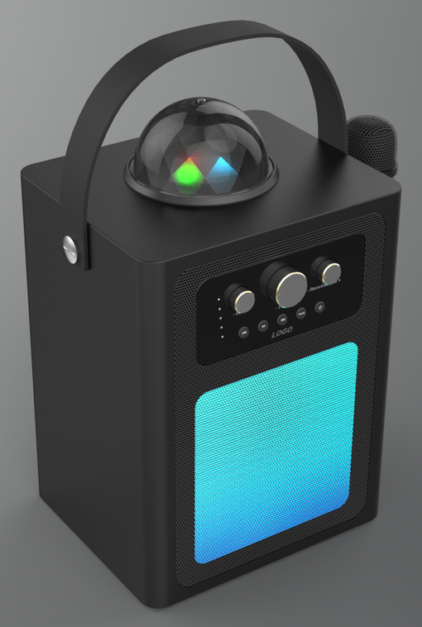
25W Disco Wooden Speaker (with wire or wireless karaoke microphone) FY-40A
2021 New Item
Specification:
1. With wire or wireless microphone, singing together with speaker (Option)
2. With LED disco light at top, front LED light, showing fashionable colorful light.
3. Output : 20W
4. Music via Bluetooth V5.0 or Micro SD card, USB or AUX-IN(mobile phone, tablets, PC...
5. Built-in rechargeable 4000mAh battery
6. Size: W190*D165*H267.5MM

Slide 8
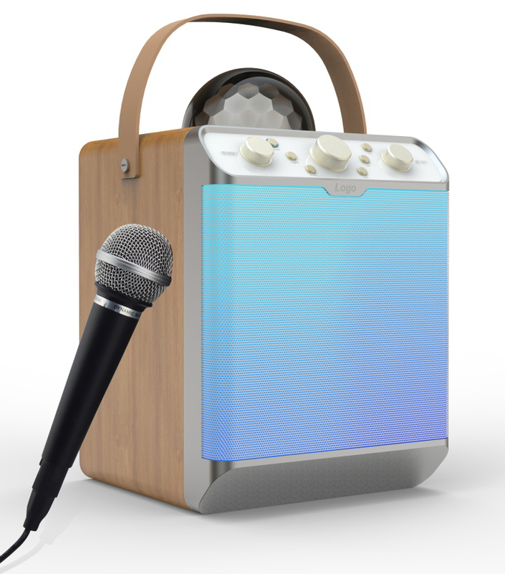
30W LED Light Wooden Speaker (with wire or wireless Karaoke Microphone)
FY-39A
Specification:
1. With wire or wireless microphone, singing together with speaker (Option)
2. With LED light at front and disco light at top, showing fashionable colorful light.
3. Output : 30W
4. Music via Bluetooth V5.0 or Micro SD card, USB or AUX-IN(mobile phone, tablets, PC...)
5. Built-in rechargeable 4000mAh battery
6. Size: W218*D229*H341MM

Slide 9
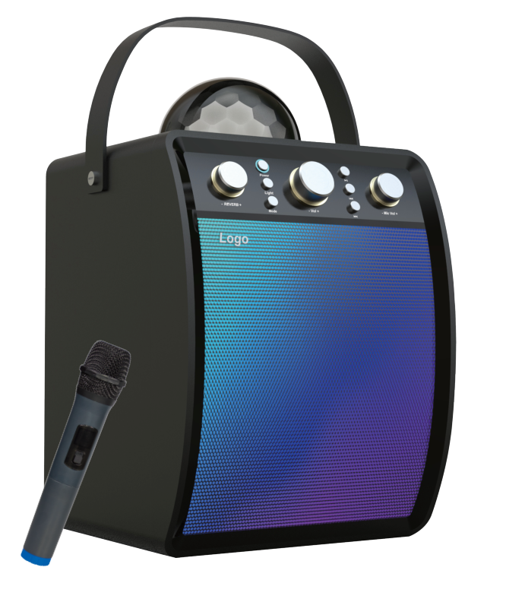
30W LED Light Wooden Speaker (with wire or wireless Karaoke Microphone) FY-39B
Specification:
1. With wire or wireless microphone, singing together with speaker (Option)
2. With LED light at front and disco light at top, showing fashionable colorful light.
3. Output : 30W
4. Music via Bluetooth V5.0 or Micro SD card, USB or AUX-IN(mobile phone, tablets, PC...)
5. Built-in rechargeable 4000mAh battery
6. Size: W218*D229*H341MM

Slide 10
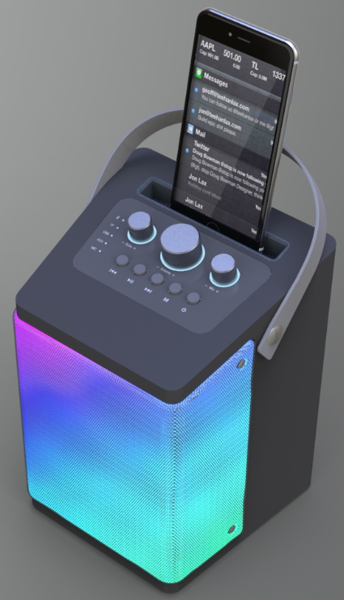
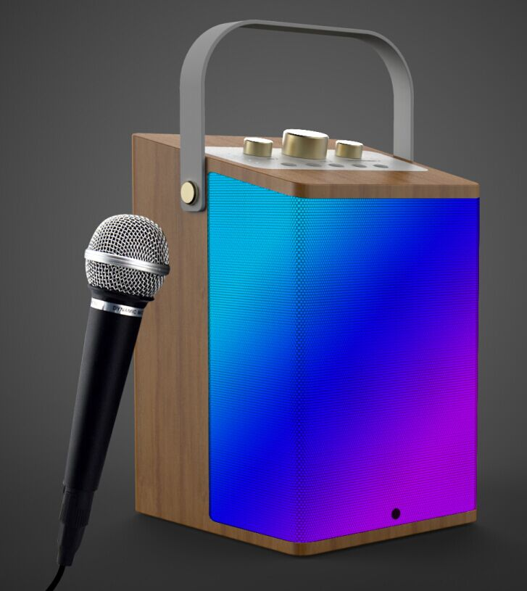
30W Disco Wooden Speaker (with wire or wireless Karaoke Microphone) FY-42
Specification:
1. With wire or wireless microphone, singing together with speaker (Option)
2. Wooden material in fashionable design.
3. Output : 30W
4. Music via Bluetooth V5.0 or Micro SD card, USB or AUX-IN(mobile phone, tablets, PC...
5. Built-in rechargeable 4000mAh battery
6. Size: 173*156*236MM

Slide 11
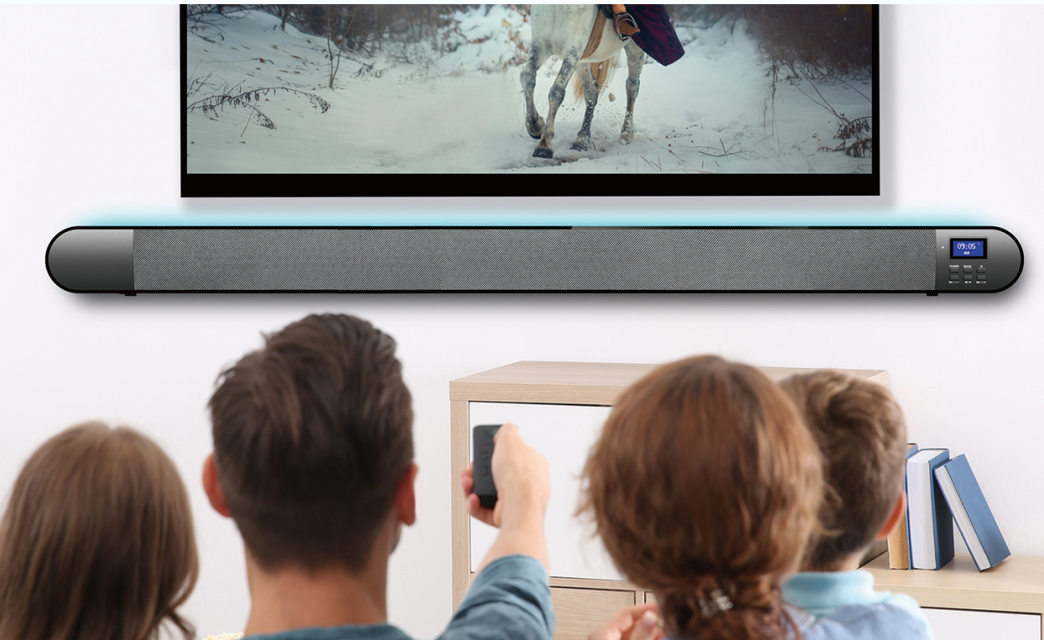
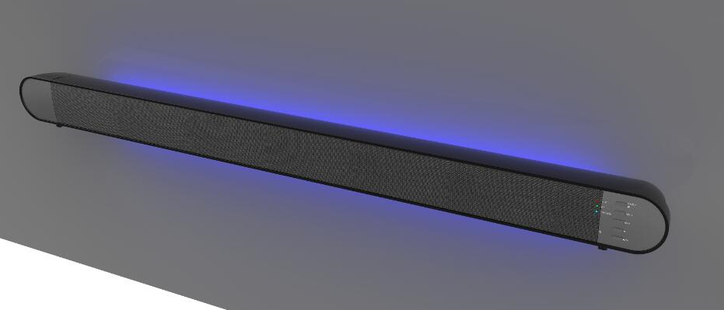
Soundbar FY-41
Specification:
1. Soundbar with Bluetooth V5.0, optical output, HDMI ARC, USB and AUX-IN,
2. Loundspeaker output: 4*10W
3. Pairing with Bluetooth enabled audio devices, smart phone, tablet, etc.
4. With LED light at back, effect light with 7 selectable colors.
5. With illuminated LCD display.
6. With remote control.
Weight: 1.9KG
Dimension: 100L * 7.5W * 7.5H CM
Package contents: Soundbar, AC adapter, AUX cable, remote control, user manual

Slide 12
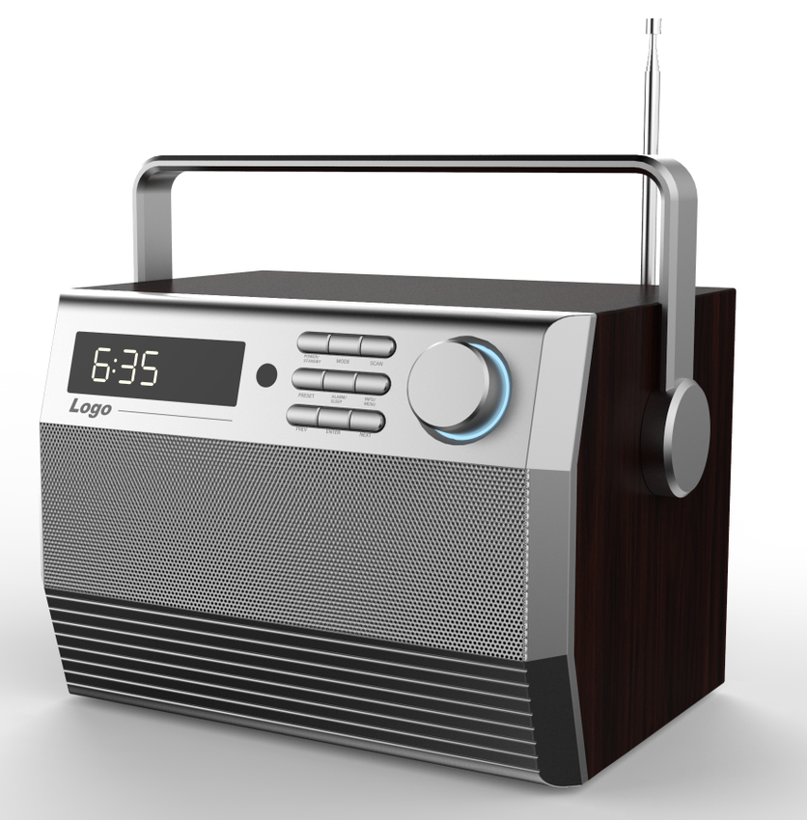
Retro Wooden Bluetooth Speaker FY-41
10W Retro Wooden Bluetooth Speaker
1. Retro wooden bluetooth speaker .
2. Support Bluetooth V5.0, USB port, TF card up to 32GB, AUX.
3. Output: 10W (5W*2)
4. Built-in rechargeable lithium battery.
5. Ideal to use at home or traveling, easiest installation, brilliant sound quality.

Slide 13
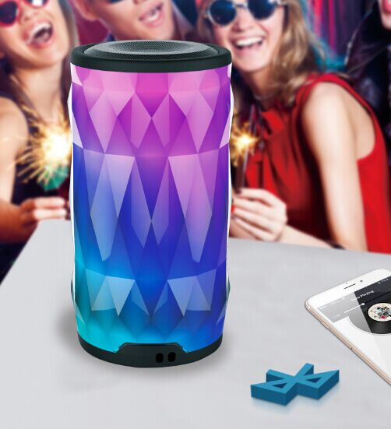
Colorful LED Bluetooth Speaker FY-35
Best Seller in Amazon
Specification:
1. Bulit-in LED light, with colorful LED show.
2. Music via Bluetooth V5.0 or Micro SD card, USB or AUX-IN(mobile phone, tablets, PC...
3. Output: Rms 5W (5W *1), high quality sound.
4. Bulit in 2000mAh rechargeable battery.

Slide 14
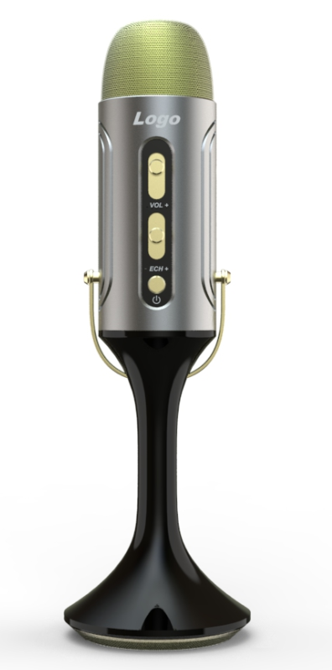
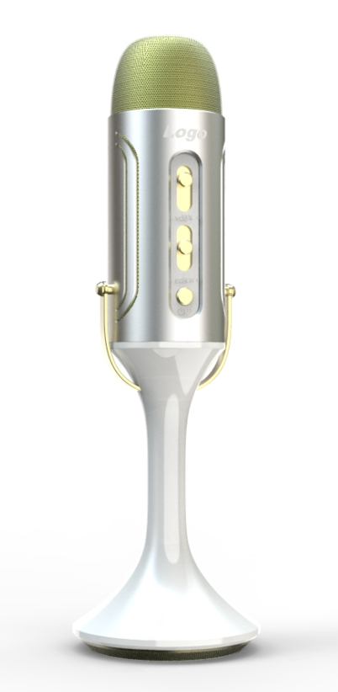
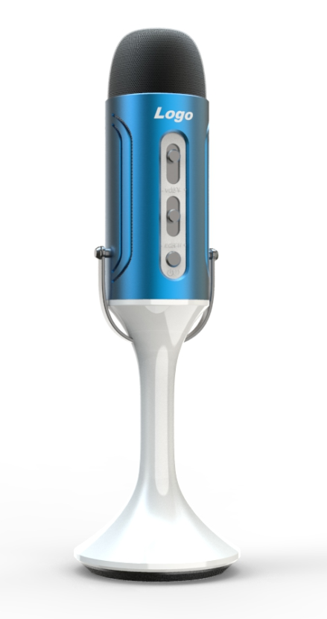
Bluetooth Karaoke Microphone M-12 (Alumium with plastic housing)
Specification:
1. 2-in-1 Karaoke microphone with bulit in 3W speaker.
2. Music via Bluetooth V5.0 or Micro SD card, USB or AUX-IN(mobile phone, tablets, PC...
3. Echo, Treble, Bass adjustment separately.
4. Bulit in 2000mAh rechargeable battery.

Slide 15
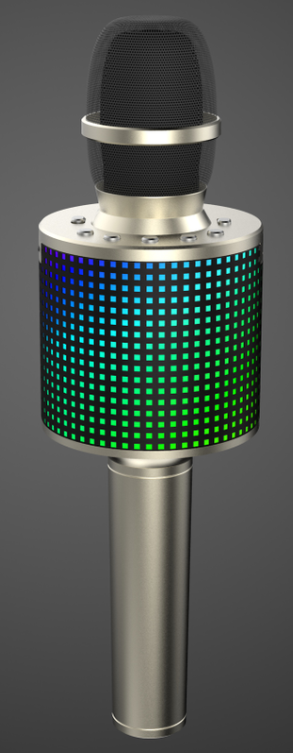
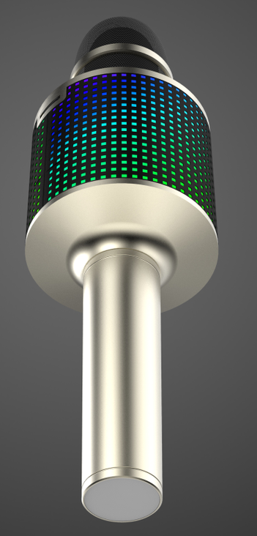
Bluetooth Karaoke Microphone with LED Light M-07
Specification:
1. Bulit-in LED light, with 360 degree colorful light show.
2. 2-in-1 Karaoke microphone with two loundspeaker driver, passitive radiator.
3. With high quality sound, output 3W * 2
4. Music via Bluetooth V5.0 or Micro SD card, or AUX-IN(mobile phone, tablets, PC...
4. Echo, Treble, Bass adjustment separately.
5. Bulit in 2000mAh rechargeable battery.

Slide 16
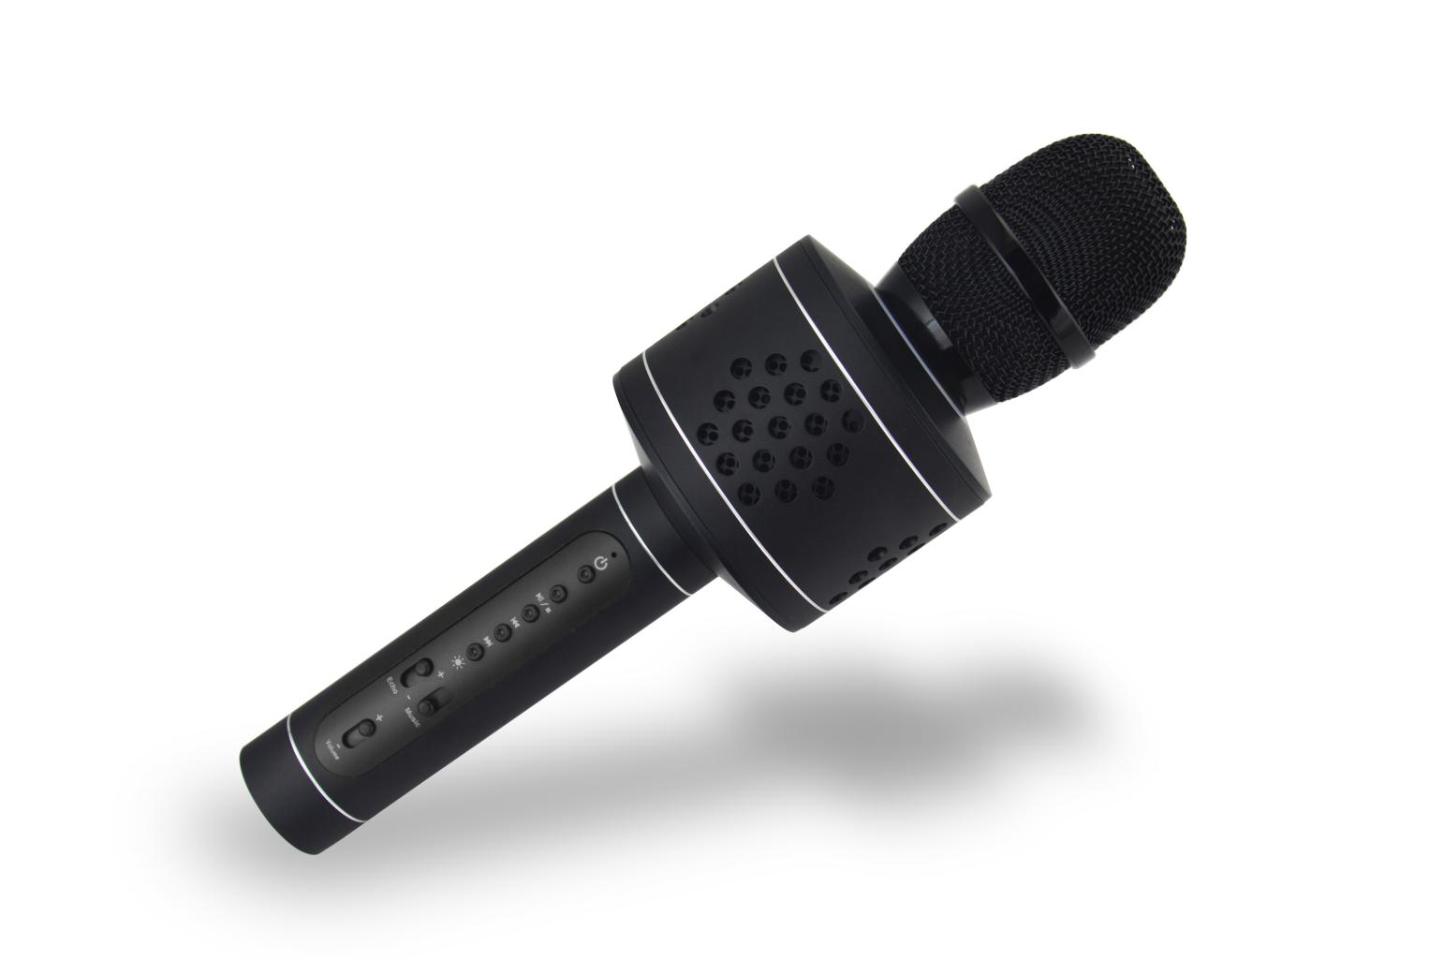
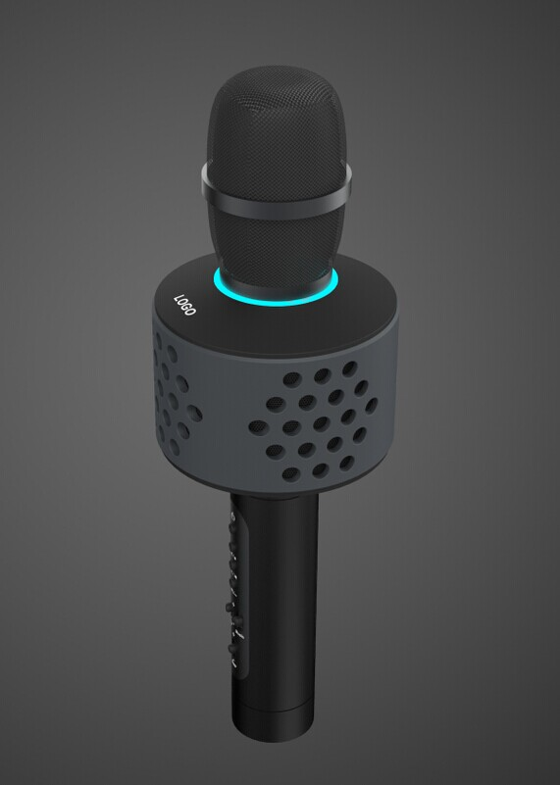
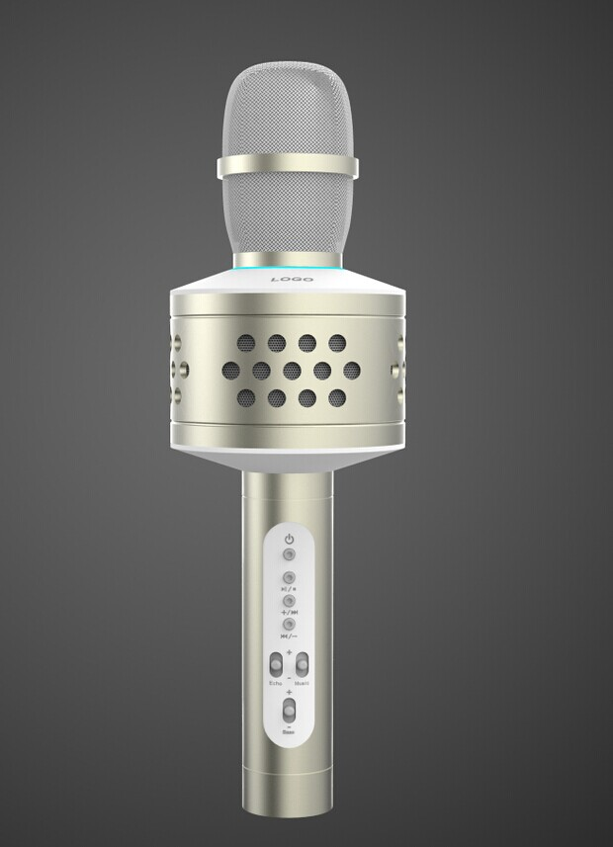
Bluetooth Karaoke Microphone (Alumium M-04B & Silica Housing M-04A)
Specification:
1. 2-in-1 Karaoke microphone with two loundspeaker driver, two passitive radiator.
2. With high quality sound, output 3W * 2
3. Music via Bluetooth V5.0 or Micro SD card, USB or AUX-IN(mobile phone, tablets, PC...
4. Echo, Treble, Bass adjustment separately.
5. Bulit in 2000mAh rechargeable battery.

Slide 17
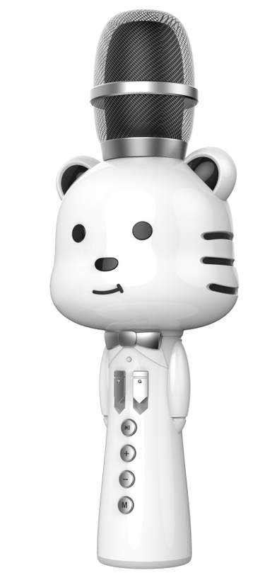
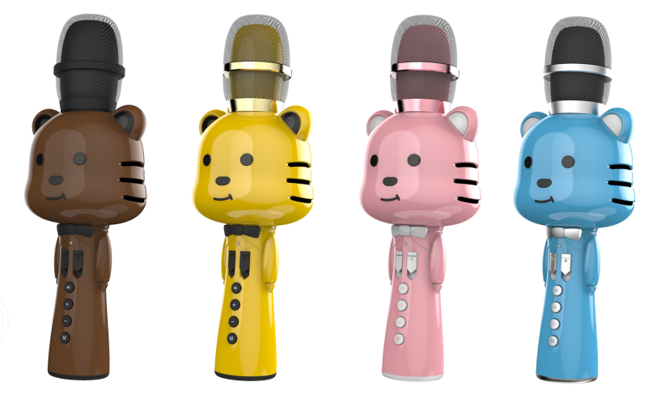
Bluetooth Karaoke Microphone For Kids M-10
Specification:
1. 2-in-1 Karaoke microphone with two loundspeaker driver, passitive radiator.
2. With high quality sound, output 3W * 2
3. Music via Bluetooth V5.0 or Micro SD card, USB or AUX-IN(mobile phone, tablets, PC...
4. Echo, Treble, Bass adjustment separately.
5. Bulit in 2000mAh rechargeable battery.

Slide 18
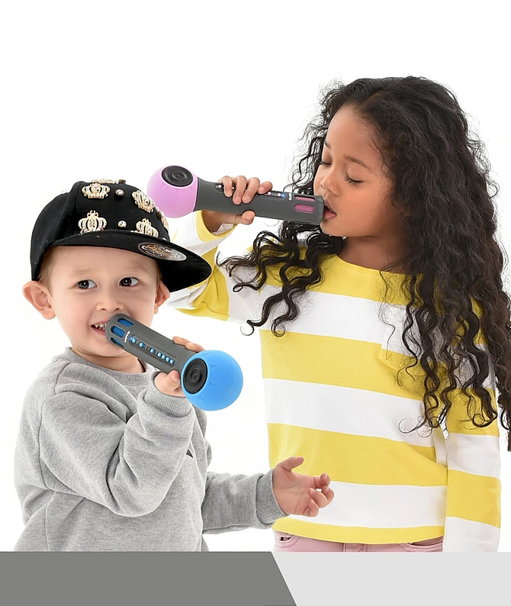
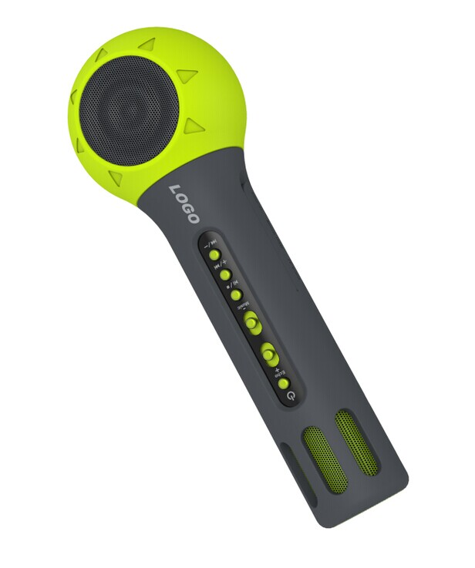
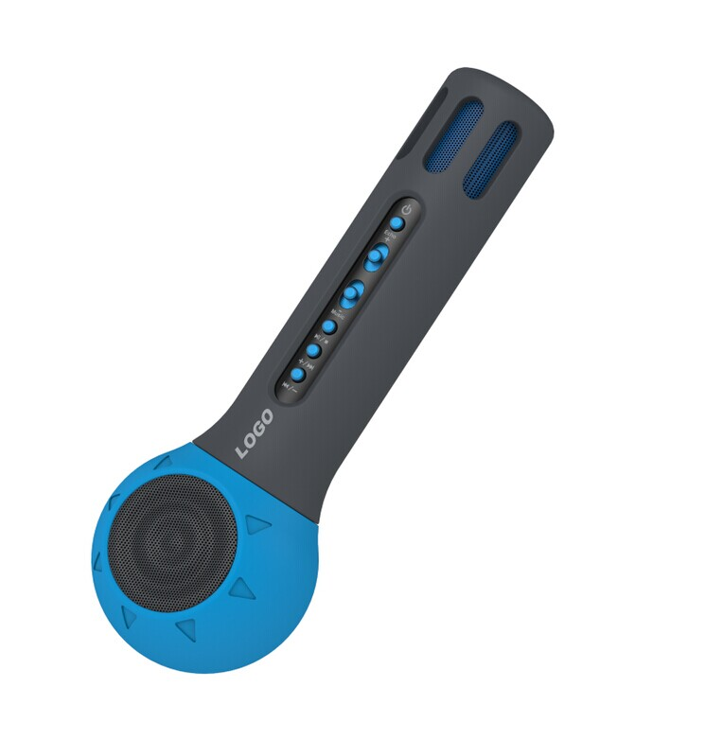
Bluetooth Karaoke Microphone For Kids M-05A
Specification:
1. 2-in-1 Karaoke microphone with bulit in 3W speaker.
2. Music via Bluetooth V5.0 or Micro SD card, USB or AUX-IN(mobile phone, tablets, PC...
3. Echo, Treble, Bass adjustment separately.
4. Bulit in 2000mAh rechargeable battery.

Slide 19
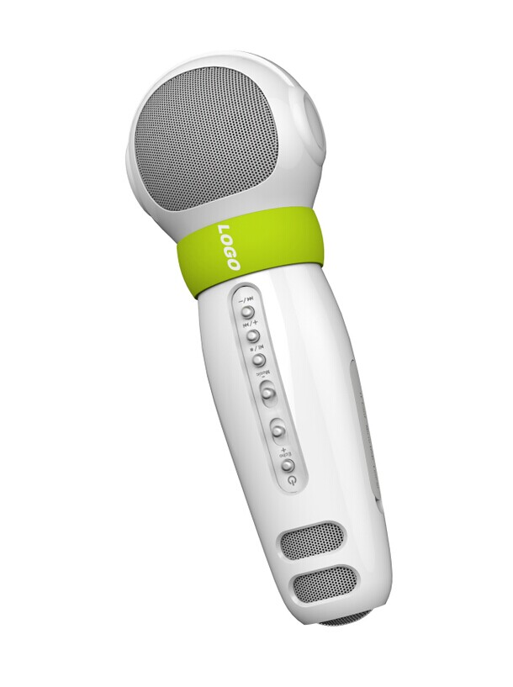
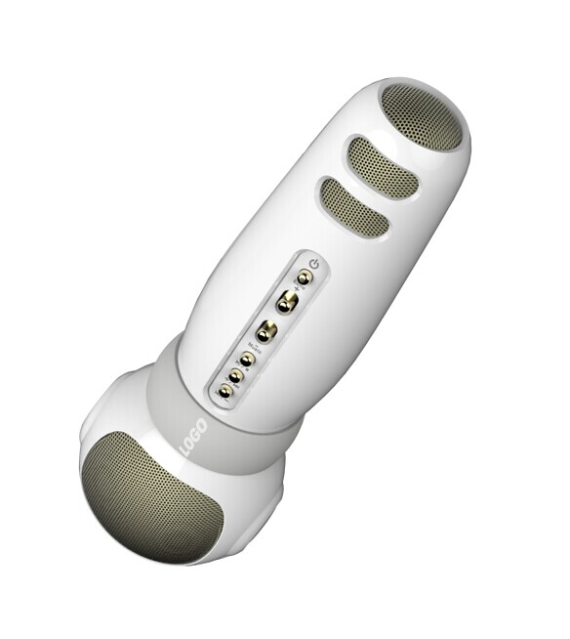
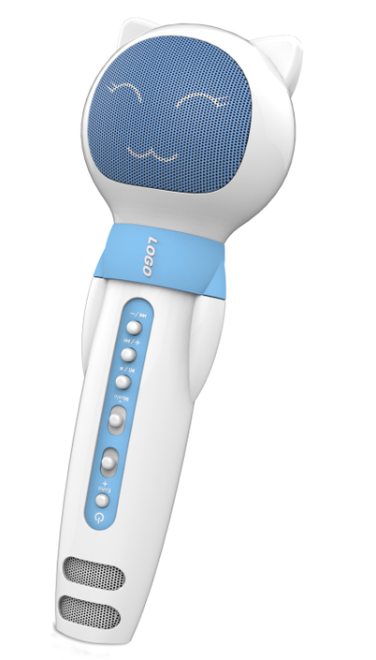
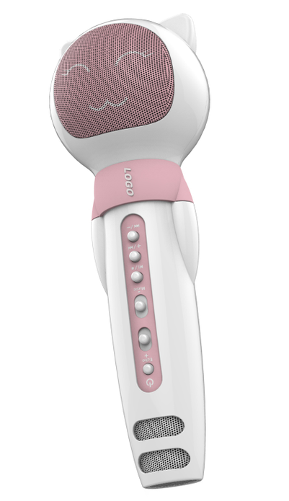
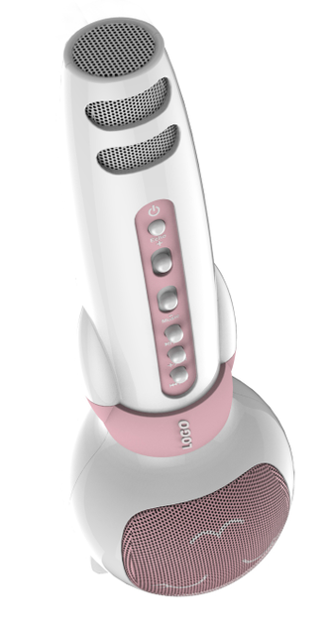
Bluetooth Karaoke Microphone For Kids (M-05B, M-08)
Specification:
1. 2-in-1 Karaoke microphone with bulit in 3W speaker.
2. Music via Bluetooth V5.0 or Micro SD card, USB or AUX-IN(mobile phone, tablets, PC...
3. Echo, Treble, Bass adjustment separately.
4. Bulit in 2000mAh rechargeable battery.

Slide 20
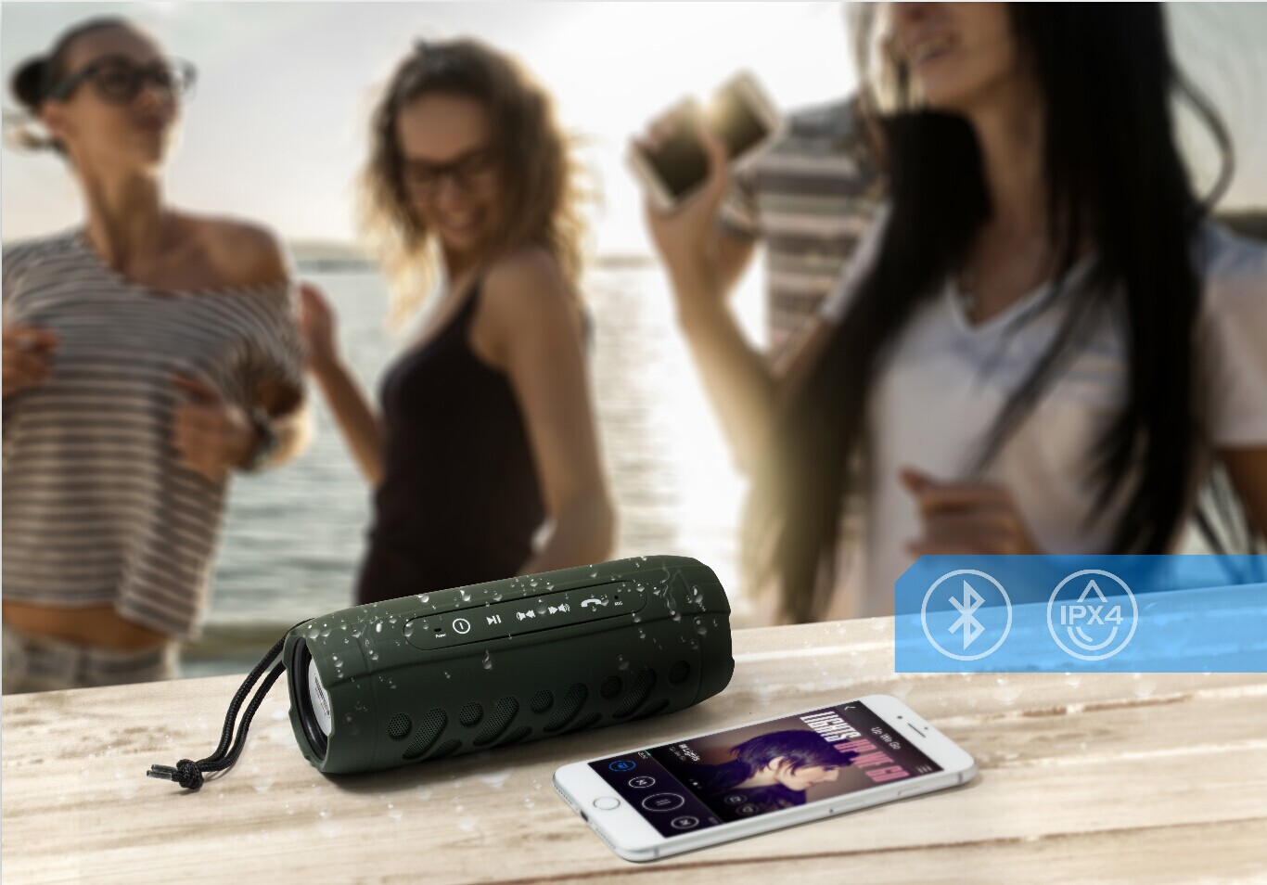
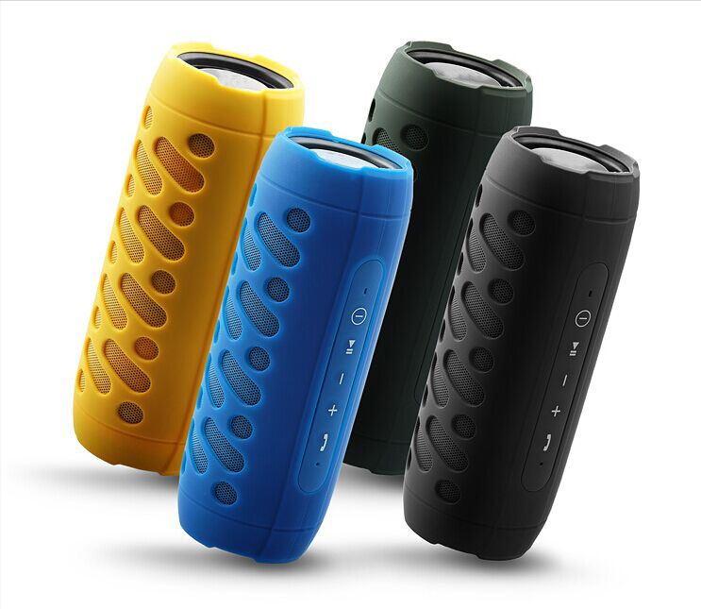
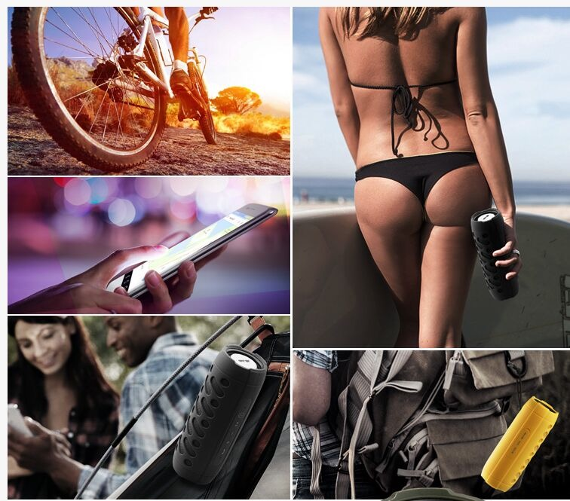
IPX5 Water Resistance Stereo Bluetooth Speaker FY-25
Specification:
1. Music via Bluetooth V5.0 or Micro SD card, or AUX-IN(mobile phone, tablets, PC...
2. Output: Rms 8W (4W * 2). Bulit in passitive radiator, good sound quality.
3. IPX5 water resistance speaker.
4. Bulit in 2000mAh rechargeable battery.

Slide 21
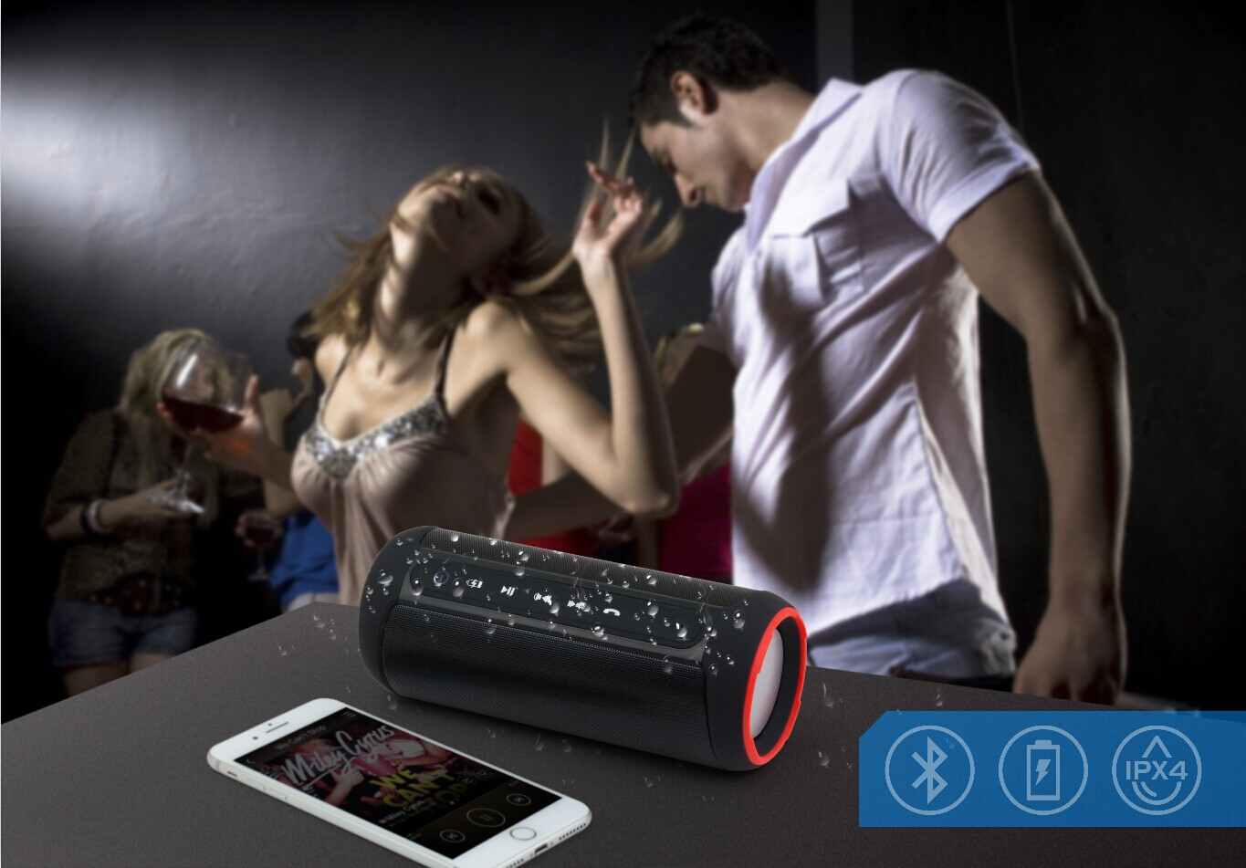
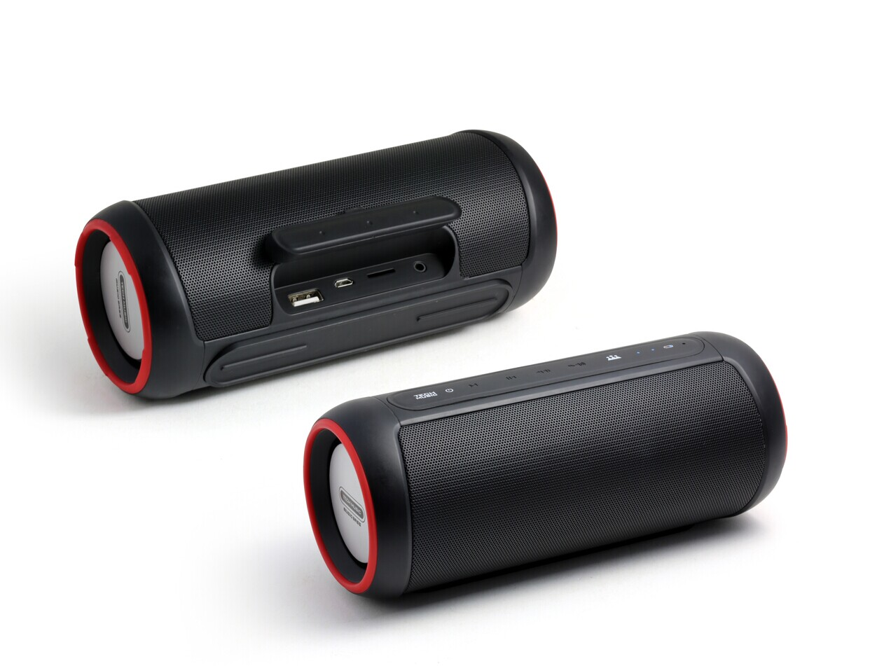
IPX5 Water Resistance 14W Powerbank Bluetooth Speaker FY-34
Specification:
1. Music via Bluetooth V5.0 or Micro SD card, or AUX-IN(mobile phone, tablets, PC...)
2. Output: Rms 14W (7W * 2).
3. Bulit in DSP chipset, with TI amplifer IC, super good sound quality.
3. IPX5 water resistance speaker.
4. Bulit in 4000mAh rechargeable battery.
With power bank function.

Slide 22
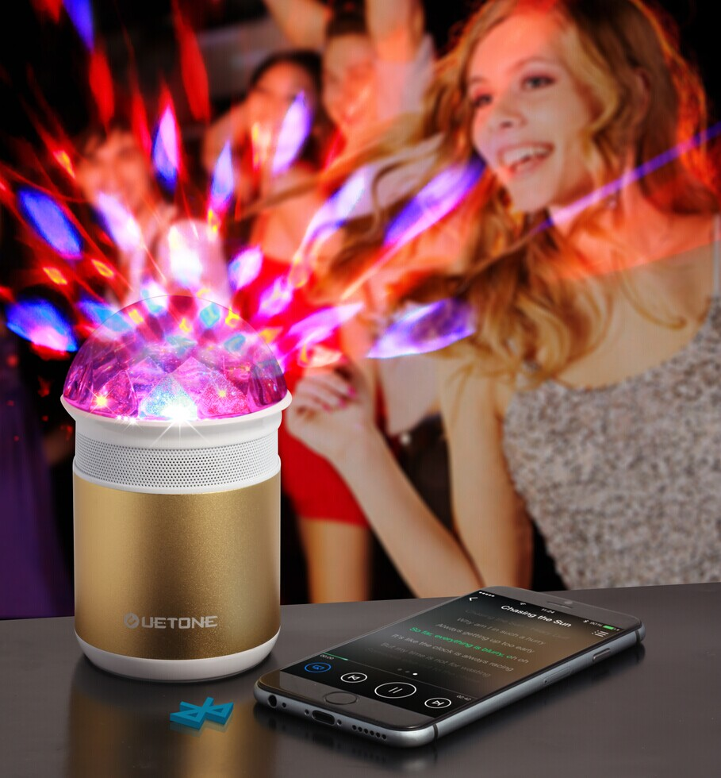
Disco LED Light Bluetooth Speaker FY-33
Specification:
1. Bulit-in LED light, with colorful LED show.
2. Music via Bluetooth V5.0 or Micro SD card, USB or AUX-IN(mobile phone, tablets, PC...
3. Output: Rms 5W (5W *1), high quality sound.
4. Bulit in 600mAh rechargeable battery.

